Slide 1

Inventory Tracker
NIE Institute of Technology, Mysuru
Department of Information Science and Engineering
Project by: Rohan S B [4NN18IS040]
Abhishek K [4NN18IS002]
Yadunandan Bhat [4NN18IS057]
Internal Guides: Mr. Sudeep J
Mrs. Shruthi B S

Slide 2
Contents
Introduction
Project Uniqueness
Techniques Used
System Requirements
Sequence Diagram
Use Case Diagram
Activity Diagram
Output
Future Enhancement
Conclusion
Bibliography
GitHub link

Slide 3
Introduction
Inventory Management refers to the process of supervising and controlling the stock items of a company.
Inventory management is important because it ensures businesses know what they’ve got in stock, where it is and how much of it they have.
Inventory management is a difficult business process to do by hand. It takes time, and if you make a mistake while recording, it could negatively impact the business.
That's why we need Inventory Tracking software, to make inventoring efficient.

Slide 4
Project Uniqueness
Easy to use command line interface, so no prior technological experience needed.
Our project is open source, so anybody can download it and use it or even contribute to its development
No maintenance required (Overhead of maintaining all the data in physical files can be eliminated).
Program takes less space on the harddisk.

Slide 5
Techniques Used:
We have used Document Processing and Indexing in this project.
Document Processing is used to collect and manipulate the raw product data into specific order. We use variable length record structure.
Primary Indexing is also used here to search the product faster.
The product ID is used for indexing.

Slide 6
System Requirements
The minimum requirements are:
Core i3 2nd Gen Processor
4GB RAM
Around 100MB harddisk space
C++ Compiler (preferably g++)
Visual Studio Code

Slide 7
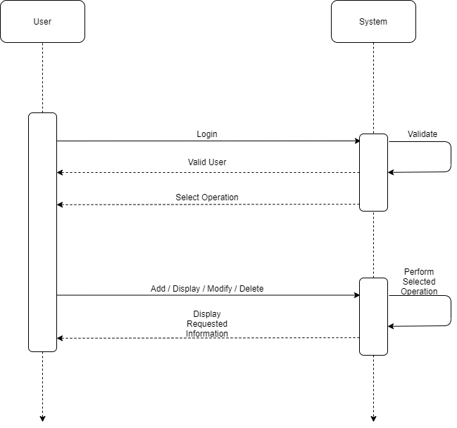
Sequence Diagram

Slide 8
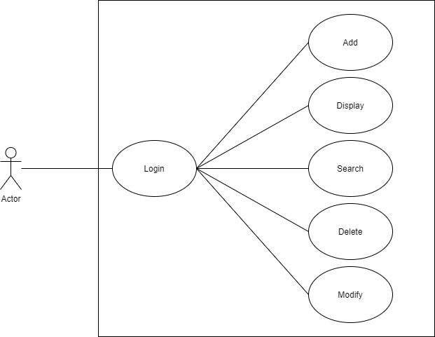
Use Case Diagram

Slide 9
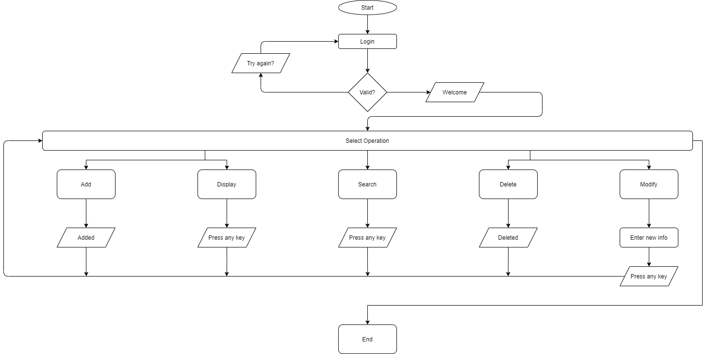
Activity Diagram

Slide 10
Output

Slide 11
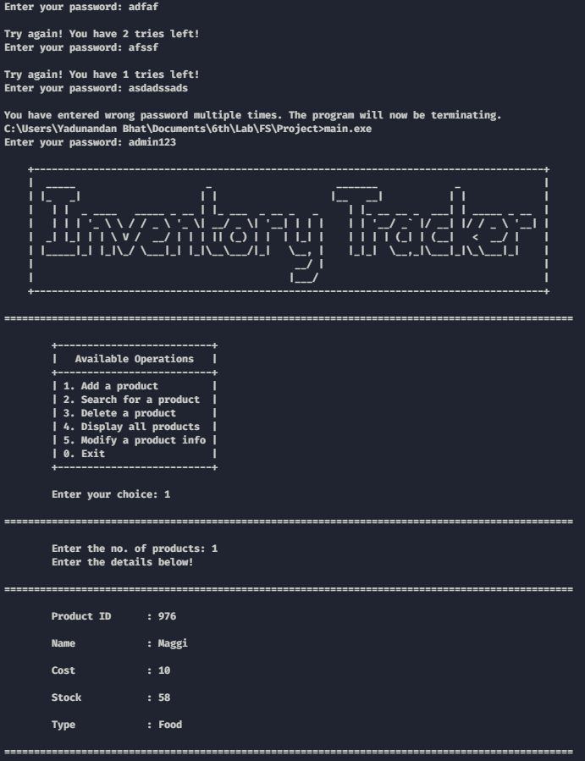
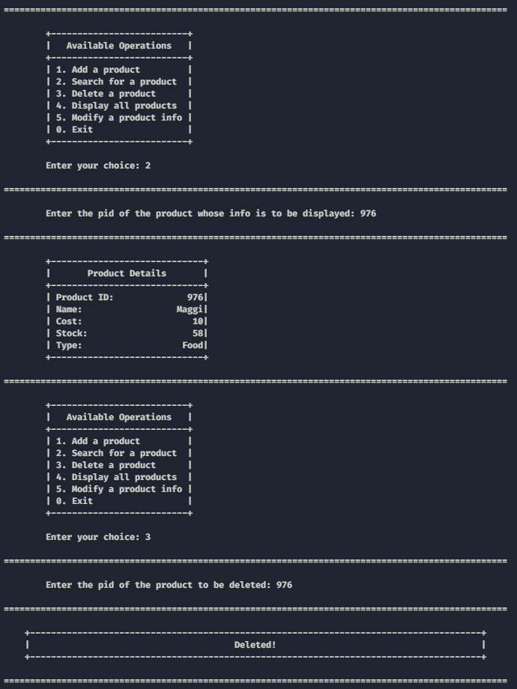

Slide 12
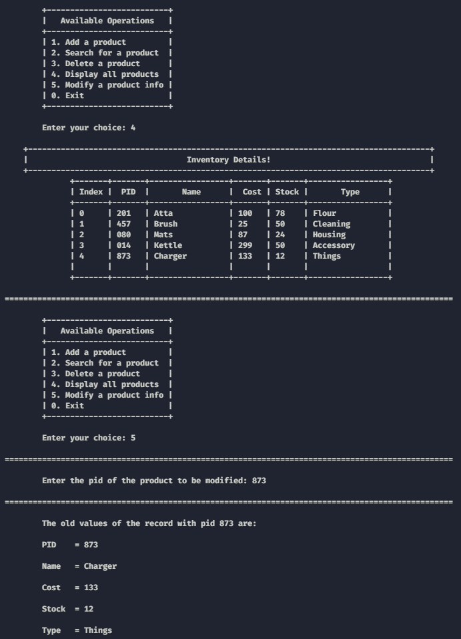
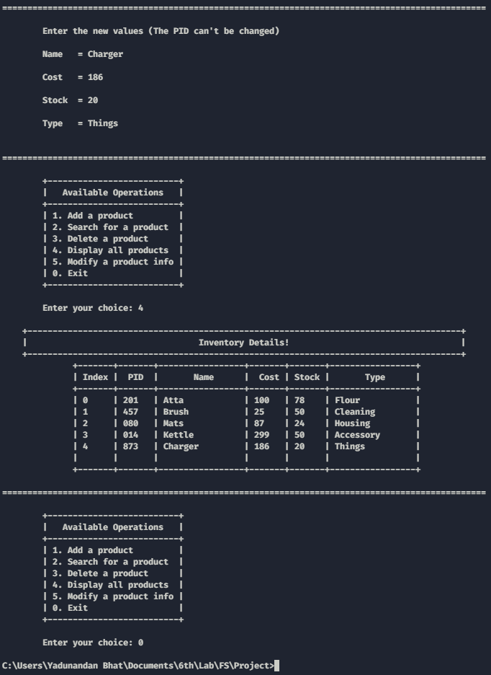

Slide 13
Future Enhancements
We could make a desktop app for this.
We can also make a website for this and host it on a server for commercial use.
We can also add billing system.
We can add inventory report generation.
We can add a feature that lets us export the data to an Excel spreadsheet.

Slide 14
Conclusion
Overall, this is just a basic implementation of an inventory tracking program in C++ using basic file structures.
This is helpful in maintaining the inventory in a simpler way.
The code used in the program is robust and understandable which helps the user to execute and retrieve the required records with ease.

Slide 15
Bibliography
Impact of Inventory Management on Firm’s Efficiency (This study investigated the effect of various inventory management factors on firm’s efficiency).
A Study on Relationship between Inventory Management and Company Performance (This study textile store as an example for the case study)

Slide 16
Thank you!
Our GitHub repo link is https://github.com/yadunandanbhat/InventoryTracker

